Slide 1

Zero trust security For an Information Control System
DANIEL QUINONES
Computer Science/Engineering/Robotics Teacher

Slide 2
About Daniel Quinones
Daniel Quiones 58 yrs old
Married with six children and 14 grand children
20+ yrs in the IT Field prior to becoming a teacher
10 yrs in the United States Marine Corps as a Force Reconnaissance Marine
5 yrs as a Computer Science/Engineering/Robotics Teacher at Franklin High School
10 yrs at EPISD
Last year I coached the number one VEX Robotics Team in the world out of 14,000 teams
I love seeing the progress of students and their success
My favorite NFL team is the Los Angeles Chargers

Slide 3
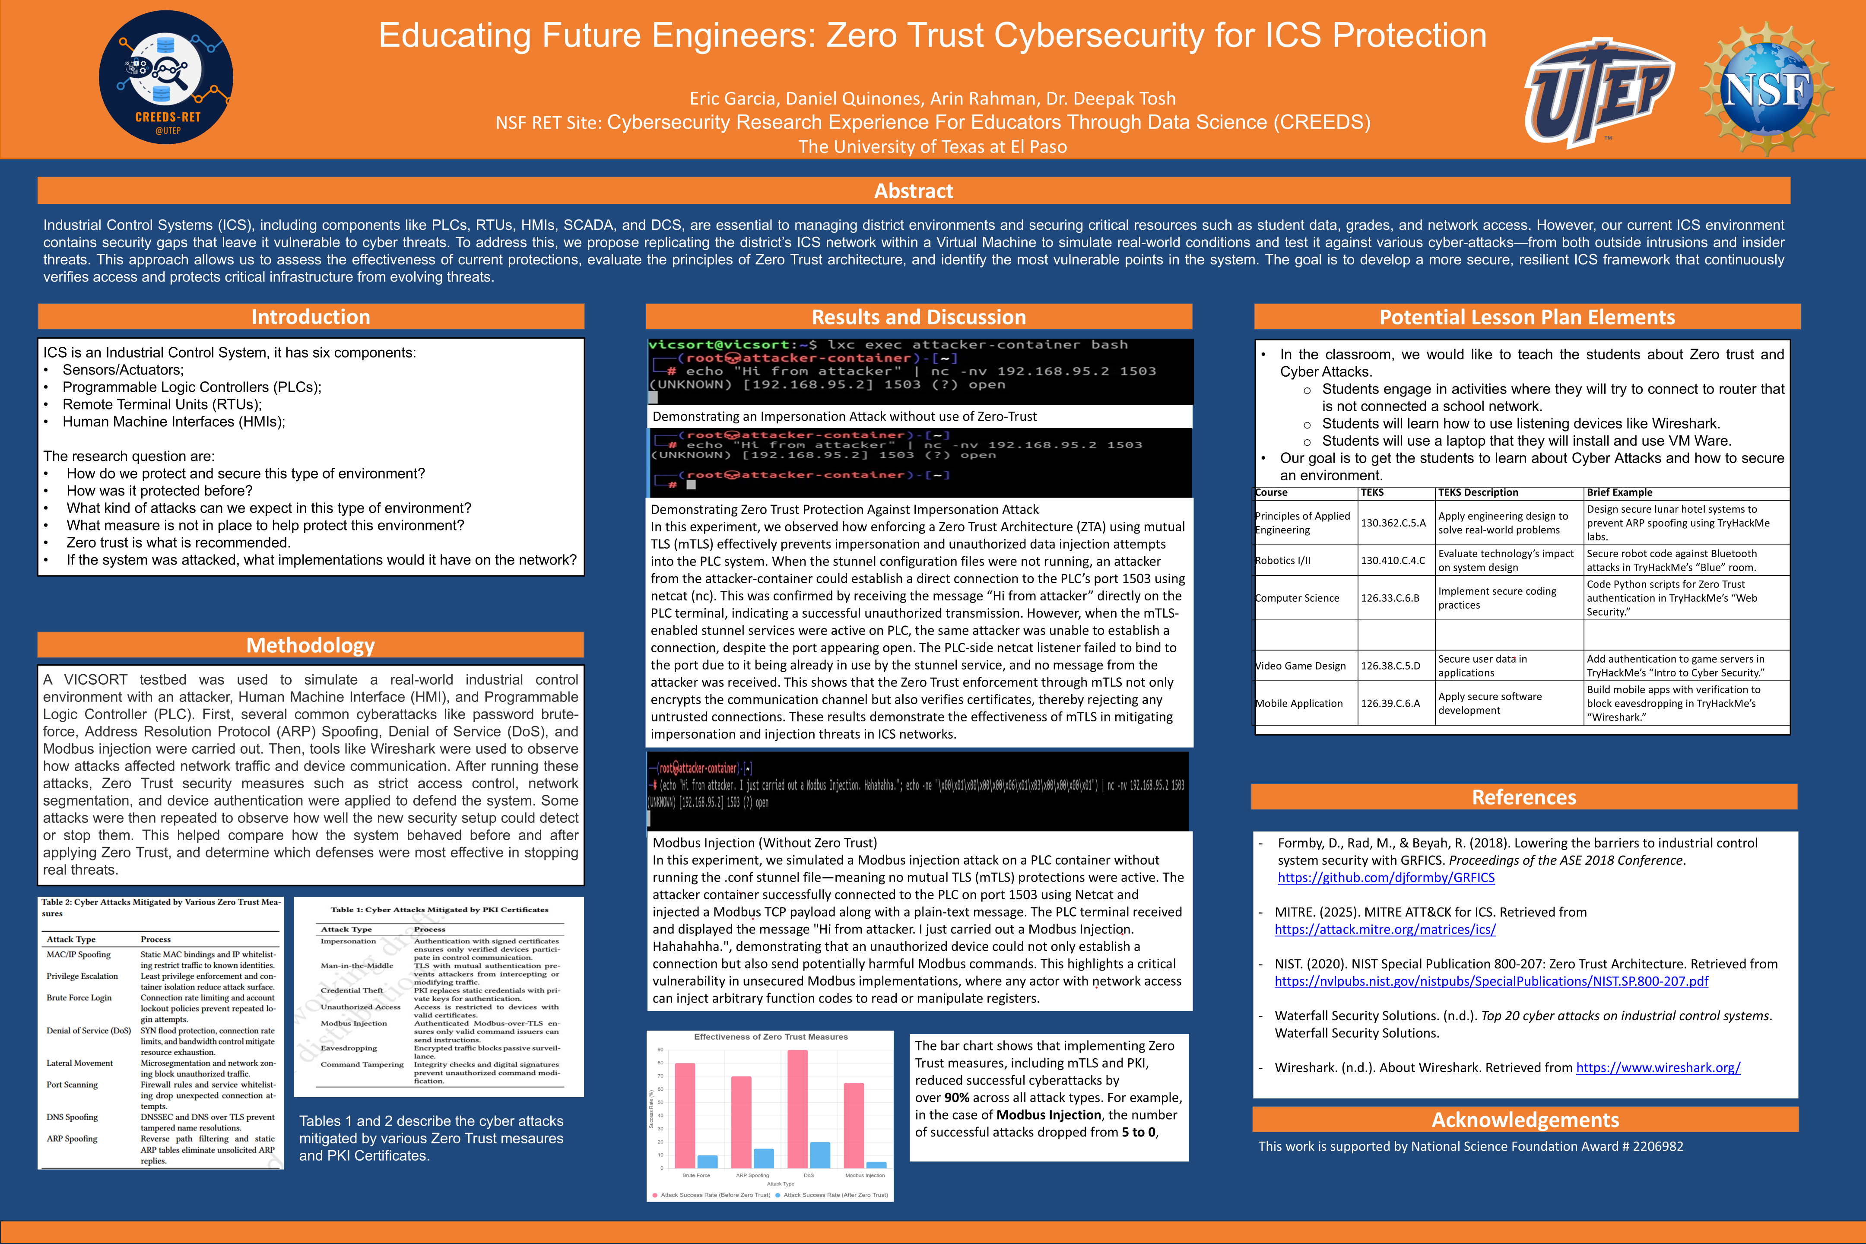

Slide 4
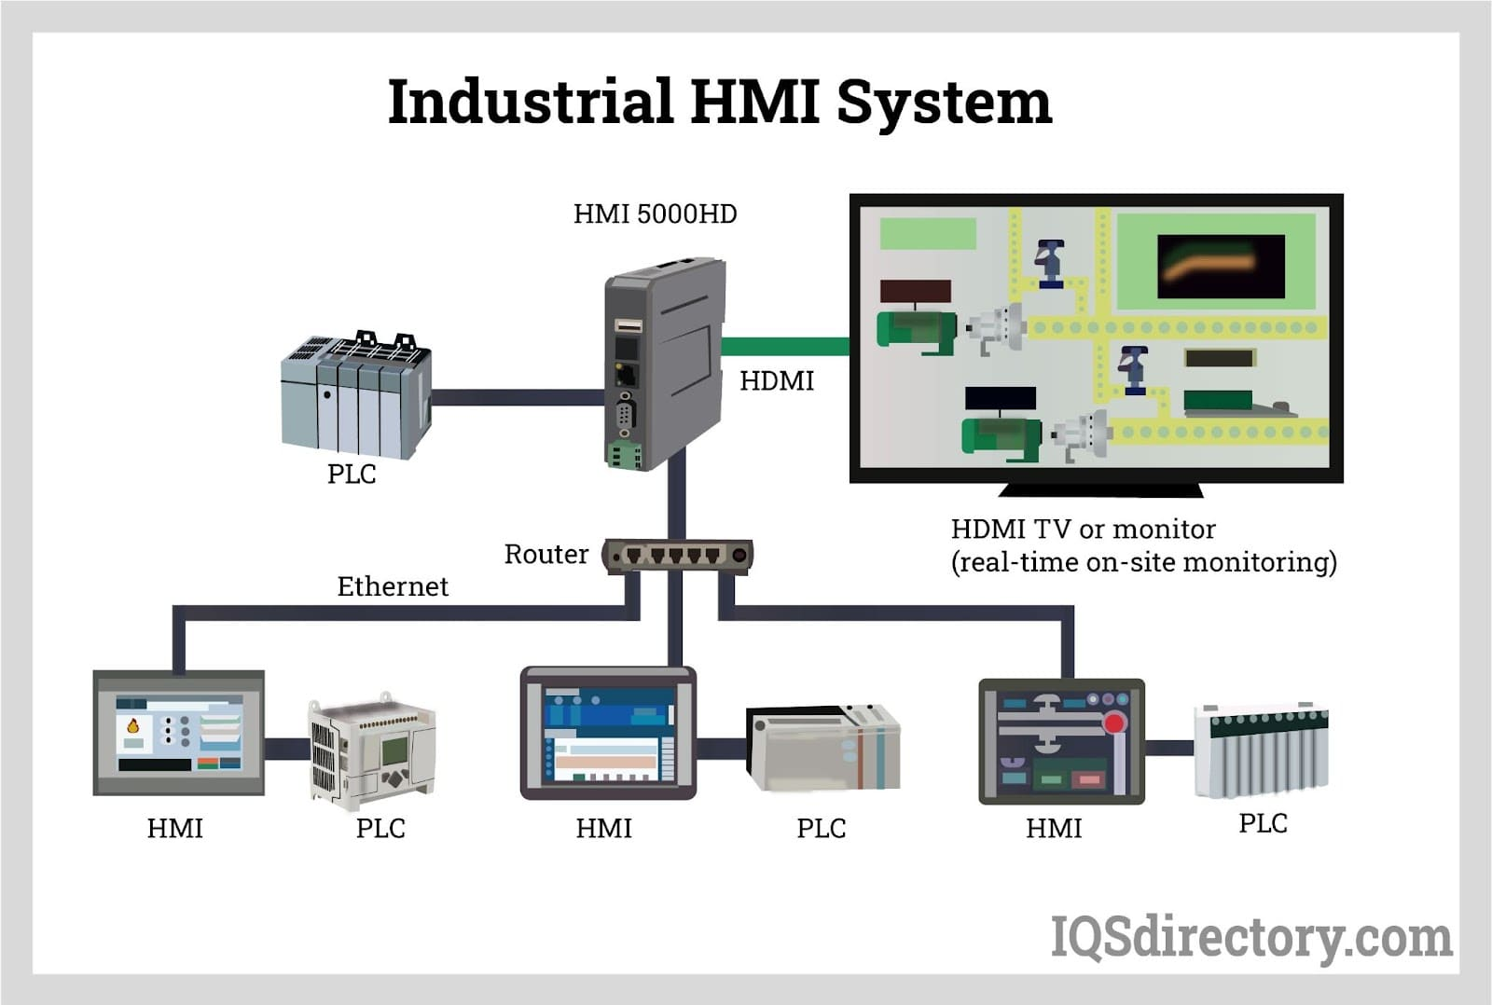

Slide 5
How I plan to Implicate Bluetooth vulnerabilities in the classroom
Explain how Bluetooth works as a communication protocol in robotics.
Identify common Bluetooth security risks (e.g., eavesdropping, Bluejacking, Bluesnarfing, man-in-the-middle attacks).
Apply best practices for securing Bluetooth-enabled robotics systems.
Analyze real-world case studies where Bluetooth vulnerabilities were exploited.
Instructional Activities
1. Engage (5 min)
Show students a Bluetooth-controlled robot (e.g., driving a small robot car with a phone app).
Ask: “What could go wrong if someone else connected to this robot?”
2. Explore (10 min)
Quick demo: Put robot in “discoverable” mode. Ask students to search for it with their devices.
Highlight how easy it is for anyone nearby to see and attempt to connect.
3. Explain (15 min)
Students work in groups to brainstorm:
  “What are three ways we can secure our classroom robots?”
  Each group shares strategies (e.g., strong PINs, disabling discoverable mode, firmware updates).
5. Evaluate (10 min)
Short quiz / exit ticket questions:
  What is Bluesnarfing?
  Why is encryption important in Bluetooth?
  Give one real-world example of a Bluetooth security risk.
  List two ways to secure a Bluetooth-enabled robot.

Slide 6
How I plan to Implicate Bluetooth vulnerabilities in the classroom
Question: “When your phone’s Bluetooth is on, who can see it?”
Quick show of Bluetooth device lists on student phones.
  Open Wireshark.
  Select the wireless interface that supports Bluetooth capture (or simulated dataset if hardware doesn’t support live capture).
  Show students how Bluetooth advertisement packets appear.
Walk students through interpreting captured packets:
  Identifying MAC addresses of Bluetooth devices.
  Filtering for Bluetooth protocols in Wireshark (e.g., bluetooth filter).
  Recognizing the difference between broadcast (advertising) and connected traffic.
Group activity: Students analyze their captures to answer:
  How many Bluetooth devices are visible in the classroom?
  Which devices are in discoverable mode?
  What information could an attacker learn from these packets?
Each group shares findings and discusses real-world risks.

Slide 7
How I plan to Implicate Bluetooth vulnerabilities in the classroom
My plan is to spend two weeks on this subject to give the students the ability to learn how vulnerable our devices are, even though we think they are secured.
Not only will we be using VEX V5 robot brains in Bluetooth communication, but we will also be using a small network router with four Raspberry Pie computers.
This will give students the opportunity to use a laptop running Wireshark to see what they can pick in the small network, also if they can pick up the VEX V5 brain that is running Bluetooth.
My goal is for the students to be aware of how vulnerable our devices are and how easy it is for them to be seen and used by someone else.
This will be taught in Principles of Applied Engineering, Robotics 1, Robotics 11, and Engineering Design.

Slide 8
Creeds 2025 Experience and how it has impacted myself
First all thank you to Dr. Ceberio, Dr. Tosh, and Dr. Robinson for this amazing experience.
For me it was an eye-opening experience in the world of research and in Cybersecurity.
I was always under the impression that on a network everything was protected, and, in all reality, it is not and how vulnerable everything to the outside world to Cyber attacks.
I now see things different when I read or hear that a power plant, a refinery, a steel mill have issues as I start wondering could this have been a cyber related attack?
I had a great experience working with all my colleges and working with the different UTEP Group leads.
I will never forget this experience and how much it has taught me, especially in the research phase.

Slide 9

Thank You
Daniel Quinones
Dan.quinonesjr@gmail.com
(915)222-6365
If you ever want to collaborate on this for your classroom, please contact me.

